Slide 1
CAREMARK

Slide 2
Guide: Prof. RAGHU B A
Special Topic II UE17CS257X- MINI PROJECT
SHIVANGI RAJ PES1201700098 SEC -C
SAIONI CHATTERJEE PES1201700118 SEC - G

Slide 3

Nowadays, due to the busy day-to-day routine life , people hardly find time to take care of their own health. Thus , consequently they start neglecting any minor issues . Moreover , the people who have recently moved to a new city , doesn’t have much knowledge about the doctors and the clinics nearby.
So, considering the above point, we are designing a website to meet the medical needs of any customer by providing entire details of the specialists , clinics and respective medicines corresponding to the problems specified by the patient.

Slide 4
In order to guide the user with proper details , he will be asked some necessary personal information such as age , gender ,blood group and weight and mainly the symptoms of the disease he is suffering from. Analysing the symptoms the user will be suggested with the medicines to the best of our knowledge . But we always advise the customer to consult the doctor if the medicine doesn’t work within 24 hours. Apart from viewing the name, The user will also be benefited with the option of ordering those medicines from our website .

Slide 5

If a person is in need of a specialist such as a gynaecologist or orthopaedic , etc , they will be getting an option to select the best doctor available nearby based on the ratings and reviews provided.
If the customer is looking for a regular check up , for them we will be providing the details of the doctors and the appointment facility.

Slide 6
HOME PAGE
The first page of our website consists of a search box asking for the requirements of the user, whether he’s in need of information regarding medicines or doctors or clinics.
The customer will be provided with options like chat with doctor , order medicines ,book an appointment or other queries .
In order to order medicine or book an appointment the user is expected to sign in to our website or create an account .
The home page will give an overall view of the top specialists, deals and offers, health tips or deals regarding check up , clicking on which the user will be directed to the respective pages.

Slide 7
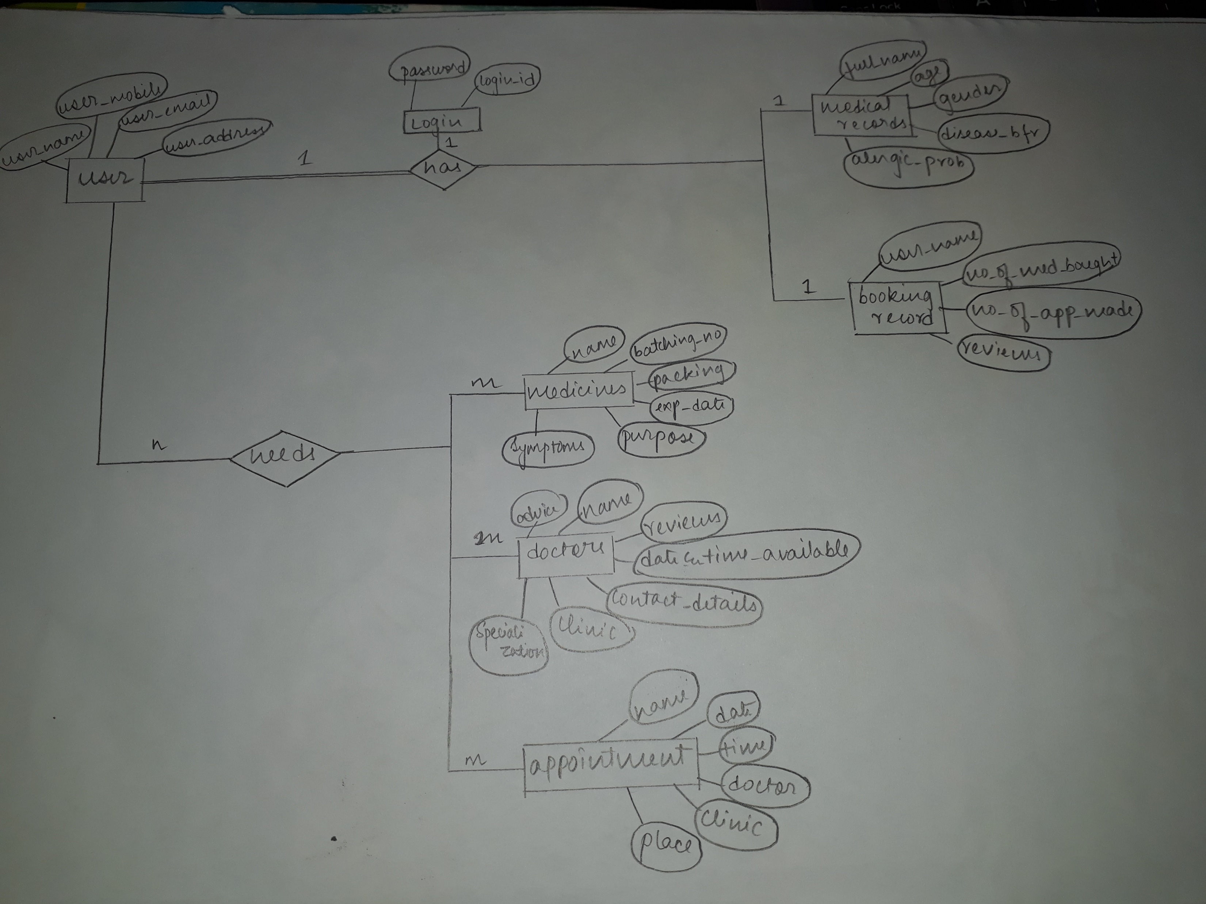
ER DIAGRAM

Slide 8
THANK YOU

